Slide 1




Enhancing Burmese News Classification with
Kolmogorov-Arnold Network Head Fine-tuning
Thura Aung, Eaint Kay Khaing Kyaw,
Ye Kyaw Thu, Thazin Myint Oo, Thepchai Supnithi

Slide 2
Outline
Introduction
Related Work
Dataset Preparation
Methodology
Experimental Setup
Result and Discussion
Conclusion and Future Work
Notes:
Kolmogorov discovered that any multivariate function can be represented using univariate functions, and Arnold refined this result so it works universally; the Kolmogorov–Arnold Network directly implements this theoretical structure using learnable univariate functions.

Slide 3
Introduction
News sentence classification assigns predefined categories to news text.
Automating classification improves speed and accuracy for large-scale news streams. This work investigates head fine-tuning with different classification heads.
Baseline: standard MLP classification head.
Compared with three KAN variants: FourierKAN, EfficientKAN, FasterKAN.
Experiments conducted on both:
Static embeddings: TF-IDF, random, fastText
Contextual embeddings: mBERT, Distil-mBERT
Notes:
Kolmogorov discovered that any multivariate function can be represented using univariate functions, and Arnold refined this result so it works universally; the Kolmogorov–Arnold Network directly implements this theoretical structure using learnable univariate functions.

Slide 4
Introduction (Cont’d)
Introduced a Burmese News Classification Dataset.
Compared performance of MLP vs. KAN-based classification heads.
EfficientKAN + fastText achieves best overall F1 score (0.928).
FasterKAN provides fastest training with competitive accuracy.
KAN heads show strong trade-offs between accuracy, parameter size, and training cost.
Results indicate KAN-based heads are lightweight yet expressive alternatives in low-resource settings.
Notes:
Kolmogorov discovered that any multivariate function can be represented using univariate functions, and Arnold refined this result so it works universally; the Kolmogorov–Arnold Network directly implements this theoretical structure using learnable univariate functions.

Slide 5
Related Work
Prior work used traditional ML models, CNN, BiLSTM, and hybrid neural models for classification.
Experiments conducted with both syllable-level and word-level tokenization.
Classification Heads and Fine-Tuning
Linear probing updates only the classification head while keeping the backbone frozen.
Effective for low-resource settings and robust under distribution shifts.
Standard practice: attach an MLP head on transformer-based backbones.
MLP heads remain widely used but may underutilize rich contextual embeddings.
Recent work proposes KAN-based heads (using FourierKAN) offering improved efficiency and performance in fine-tuning tasks.
Notes:
Kolmogorov discovered that any multivariate function can be represented using univariate functions, and Arnold refined this result so it works universally; the Kolmogorov–Arnold Network directly implements this theoretical structure using learnable univariate functions.

Slide 6
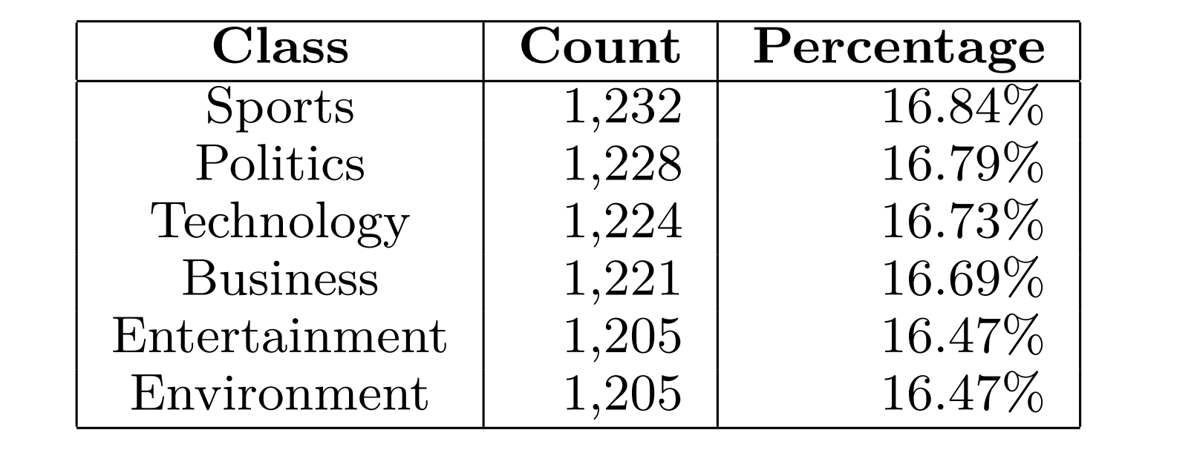
Dataset Preparation
Table 1: Label Counts and Percentages
Collected Burmese news across six categories from major news outlets (VOA Burmese, BBC Burmese, RFA).
Manually annotated by native speakers (April–June 2024).
Dataset split: 80% training (5.84k sentences) and 20% testing (1.47k sentences).
Text cleaning and normalization to ensure correct Unicode ordering and reliable segmentation.
Tokenization:
mBERT tokenizer for transformer-based models
myWord tool for static embedding models using unigram/bigram dictionaries
Dataset includes representative examples for all six categories.
Notes:
Kolmogorov discovered that any multivariate function can be represented using univariate functions, and Arnold refined this result so it works universally; the Kolmogorov–Arnold Network directly implements this theoretical structure using learnable univariate functions.

Slide 7
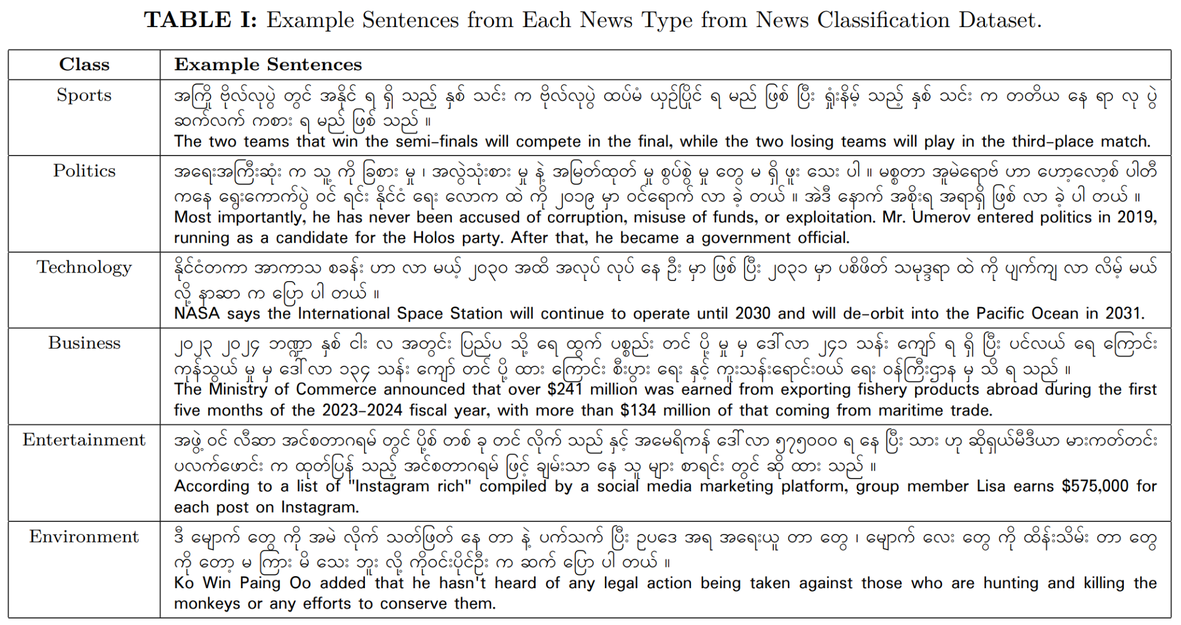
Dataset Preparation (Cont’d)
Table 2: Example Sentences from Each News Type from News Classification Dataset.

Slide 8
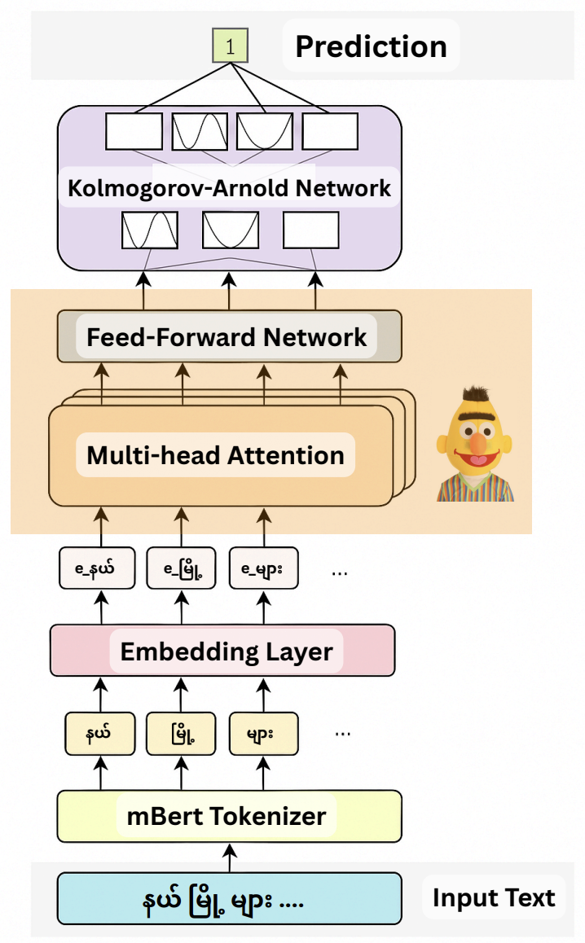
Methodology: Embeddings
Goal: evaluate different embedding strategies combined with different classification heads while keeping the backbone frozen.
Neural embeddings map tokens into continuous vectors capturing semantic and syntactic relationships.
Static: TF-IDF, Random and, fastText embeddings.
Contextual: mBERT and Distil-mBERT encoders.
Static embeddings provide fixed representations; contextual embeddings encode tokens based on sentence context.
Only the classification head is fine-tuned for all setups.
Figure 1: Integration of KAN as a classification head on top of a Transformer encoder for context-aware prediction

Slide 9
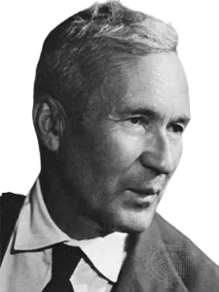
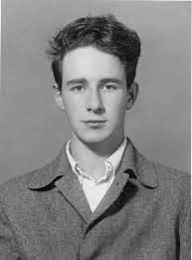
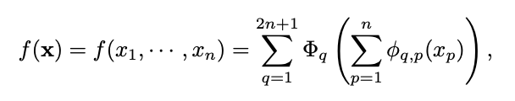
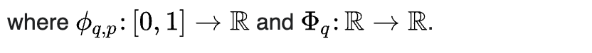
Methodology: Kolmogorov-Arnold Representation Theorem
The works of Vladimir Arnold and Andrey Kolmogorov established that if f is a multivariate continuous function, then f can be expressed as a finite composition of continuous functions of a single variable and the binary operation of addition.
Andrey Kolmogorov
Vladimir Arnold
Notes:
Kolmogorov discovered that any multivariate function can be represented using univariate functions, and Arnold refined this result so it works universally; the Kolmogorov–Arnold Network directly implements this theoretical structure using learnable univariate functions.

Slide 10

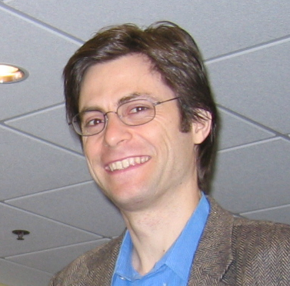
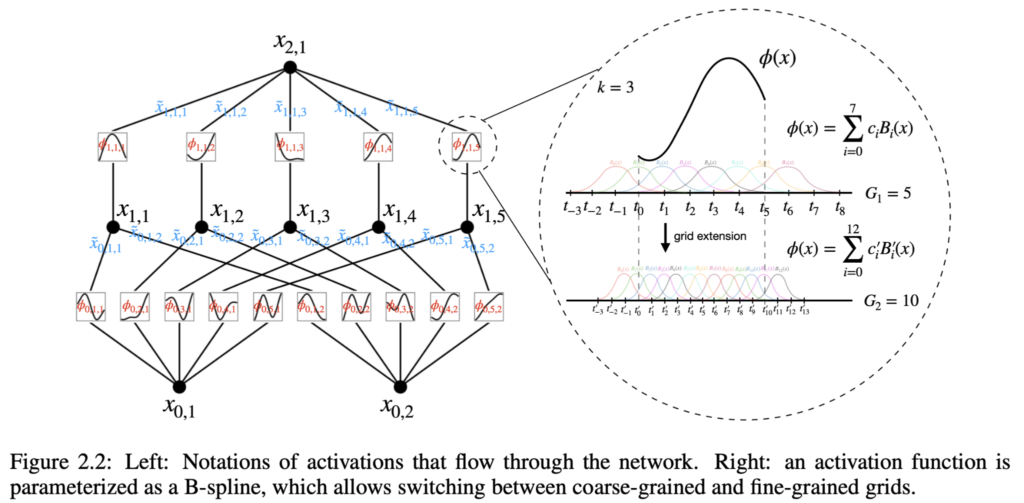
Methodology: Kolmogorov-Arnold Network
KAN: If f is a multivariate continuous function, then f can be approximated as a finite composition of continuous functions of a single variable and the binary operation of addition.
Ziming Liu
Max Tegmark
Liu, Z., Wang, Y., Vaidya, S., Ruehle, F., Halverson, J., Soljacic, M., Hou, T., & Tegmark, M. (2025). KAN: Kolmogorov–Arnold Networks. In Y. Yue, A. Garg, N. Peng, F. Sha, & R. Yu (Eds.), International Conference on Representation Learning (pp. 70367–70413).
Notes:
Kolmogorov discovered that any multivariate function can be represented using univariate functions, and Arnold refined this result so it works universally; the Kolmogorov–Arnold Network directly implements this theoretical structure using learnable univariate functions.

Slide 11
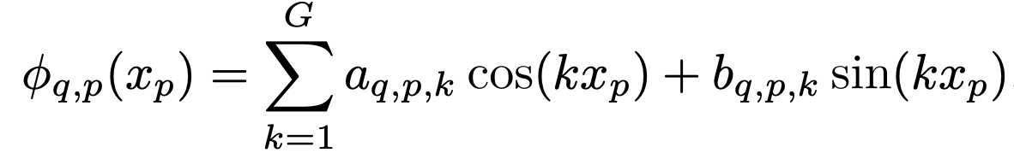
Methodology: Kolmogorov-Arnold Network (Cont’d)
FourierKAN
Replaces spline activations with Fourier series expansions.
Approximates functions as sums of sine and cosine terms:
Efficiently models smooth, periodic, and non-linear patterns.
Benefits: smoother gradients, easier initialization, compact parameterization.
EfficientKAN
Enforces sparsity via L1 regularization on weights instead of expanded inputs.
Optional learnable scaling for activation functions allows trade-off between accuracy and efficiency.
FasterKAN
Reduces memory usage by applying activations first, then linear combination.
Uses Reflectional Switch Activation Functions (RSWAF) to approximate splines.
Benefits: lower memory, faster forward/backward computations, flexible basis functions.
Notes:
Kolmogorov discovered that any multivariate function can be represented using univariate functions, and Arnold refined this result so it works universally; the Kolmogorov–Arnold Network directly implements this theoretical structure using learnable univariate functions.

Slide 12
Experimental Setup
Experiments conducted on Google Colab with NVIDIA Tesla T4 (16 GB VRAM).
Implemented in PyTorch; evaluation with scikit-learn; pre-trained backbones via Hugging Face Transformers.
Embeddings:
Static: TF-IDF, random, fastText
Contextual: mBERT, Distil-mBERT
Classification heads:
MLP – Feed-forward with ReLU
FourierKAN – Fourier-based, grid size 8
EfficientKAN – Spline-based, grid size 8, cubic splines
FasterKAN – Grid-based, learnable grid, inverse denominator formulation
Notes:
Kolmogorov discovered that any multivariate function can be represented using univariate functions, and Arnold refined this result so it works universally; the Kolmogorov–Arnold Network directly implements this theoretical structure using learnable univariate functions.

Slide 13
Experimental Setup (Cont’d)
Optimizer: AdamW with two-tier LR: 2e-4 for head
Scheduler: Cosine Annealing
Loss: Cross-entropy
Training:
Static embeddings: 15 epochs, batch size 32
Transformer-backbones: 5 epochs, batch size 8
Gradient clipping (max-norm = 1.0)
Dropout: 0.3; Early stopping with patience = 3
Evaluation:
Weighted F1-score on test set
Computational metrics: total/trainable parameters, training time, forward/backward latency
Notes:
Kolmogorov discovered that any multivariate function can be represented using univariate functions, and Arnold refined this result so it works universally; the Kolmogorov–Arnold Network directly implements this theoretical structure using learnable univariate functions.

Slide 14
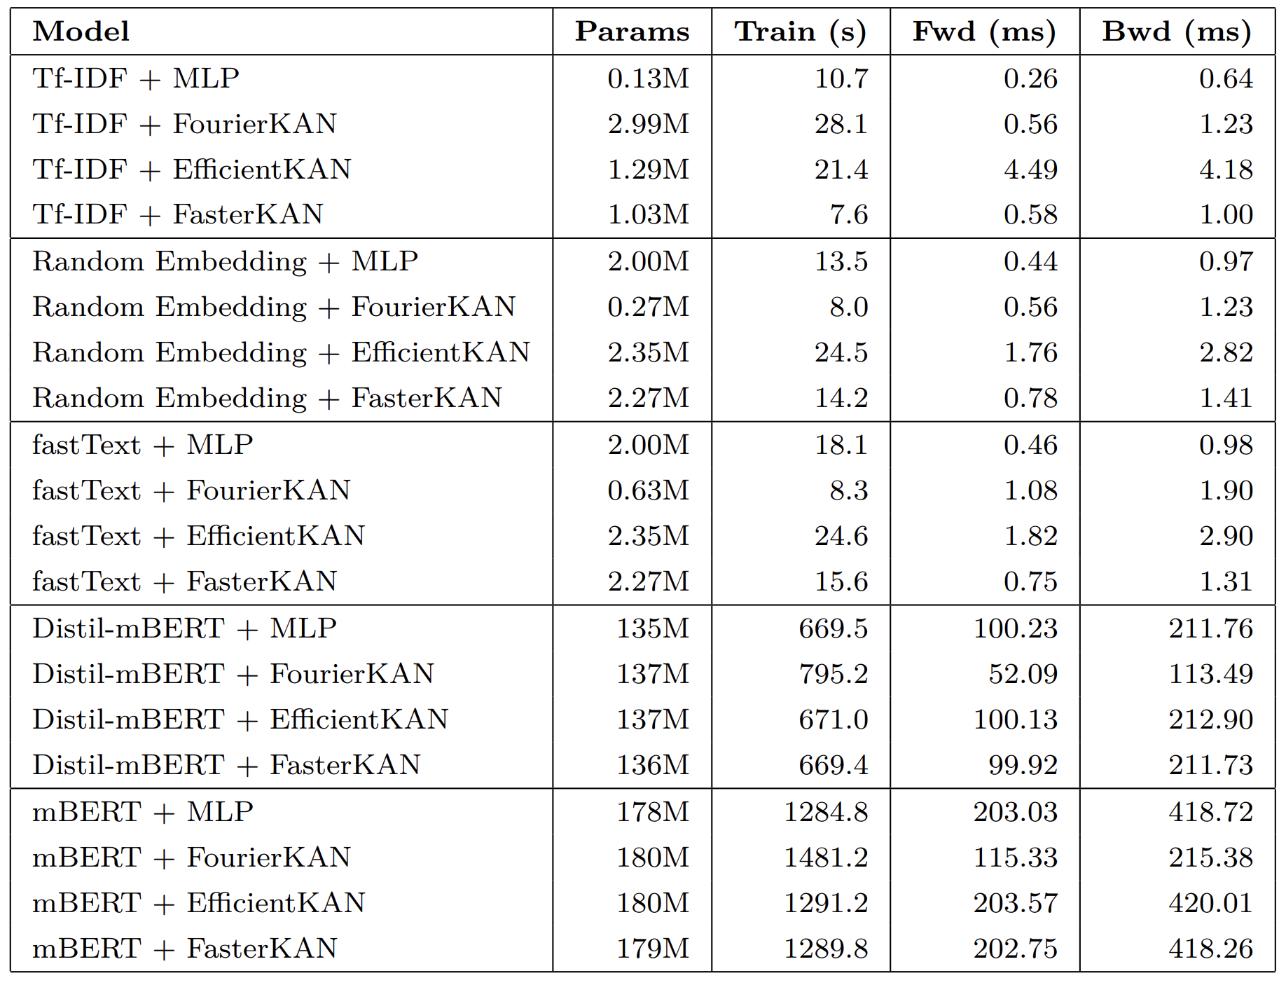
Result and Discussion: Efficiency
Table 3: Efficiency comparison of models with different embeddings
Notes:
Kolmogorov discovered that any multivariate function can be represented using univariate functions, and Arnold refined this result so it works universally; the Kolmogorov–Arnold Network directly implements this theoretical structure using learnable univariate functions.

Slide 15
Result and Discussion: Efficiency (Cont’d)
Training time:
MLP generally fastest across embeddings.
FasterKAN often trains faster than MLP despite more parameters.
EfficientKAN requires significantly longer training.
Transformer-based models (mBERT, Distil-mBERT) are slowest (hundreds–over 1000 sec).
Inference and backward propagation latency:
MLP: lowest latency (forward 0.26–0.46 ms, backward 0.64–0.98 ms).
FourierKAN: slightly higher latency but efficient (forward 0.56–1.08 ms, backward 1.23–1.90 ms).
FasterKAN: moderate overhead (forward 0.58–0.78 ms, backward 1.0–1.41 ms).
EfficientKAN: slowest among non-transformers (forward 1.76–4.49 ms, backward up to 4.18 ms).
Transformers: high latency (Distil-mBERT forward 52–100 ms, backward 113–212 ms; mBERT forward 115+ ms, backward 215–418 ms)
Notes:
Kolmogorov discovered that any multivariate function can be represented using univariate functions, and Arnold refined this result so it works universally; the Kolmogorov–Arnold Network directly implements this theoretical structure using learnable univariate functions.

Slide 16
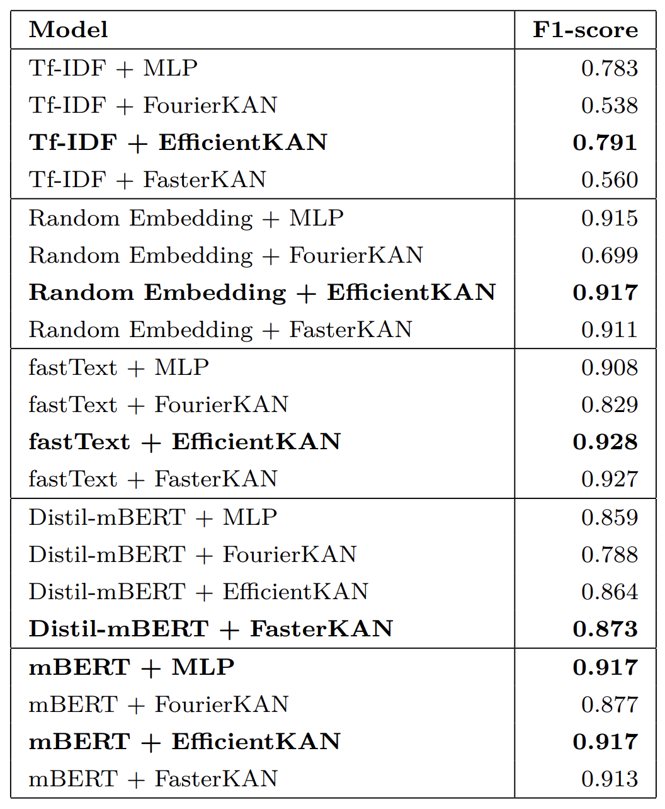
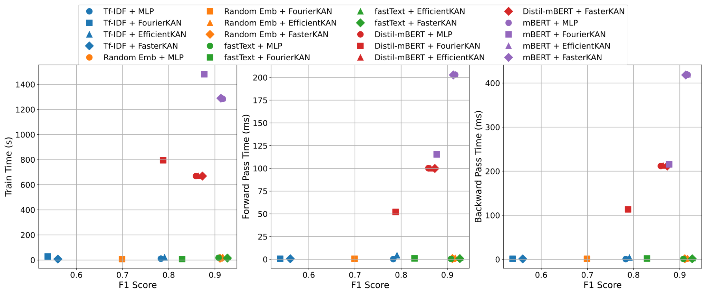
Result and Discussion (Cont’d)
Figure 2: Comparison of model performance versus computational cost
Table 4: F1-score comparison of classification heads across embeddings
Notes:
Kolmogorov discovered that any multivariate function can be represented using univariate functions, and Arnold refined this result so it works universally; the Kolmogorov–Arnold Network directly implements this theoretical structure using learnable univariate functions.

Slide 17
Result and Discussion: Performance (Cont’d)
Effect of classification head (F1-score):
EfficientKAN highest for classical embeddings (e.g., TF-IDF: 0.791).
MLP and FasterKAN competitive; FourierKAN generally lower.
For transformer embeddings, MLP or FasterKAN perform best; FourierKAN slightly lower but competitive.
Effect of embedding type:
Neural Network embeddings (Random, fastText) outperform TF-IDF across all heads.
fastText usually yields highest F1, followed by Random and Fourier.
Transformer embeddings give modest additional gains over fastText.
Notes:
Kolmogorov discovered that any multivariate function can be represented using univariate functions, and Arnold refined this result so it works universally; the Kolmogorov–Arnold Network directly implements this theoretical structure using learnable univariate functions.

Slide 18
Conclusion and Future Work
Explored KAN variants (EfficientKAN, FasterKAN, FourierKAN) as classification heads for Burmese news sentence classification.
Key findings:
Embedding type has the largest impact on performance.
Neural Network based word embeddings (Random, fastText) outperform TF-IDF.
Transformer embeddings (mBERT, Distil-mBERT) achieve highest accuracy.
EfficientKAN performs best with static embeddings (fastText: 0.928 F1).
FasterKAN balances speed and accuracy efficiently.
FourierKAN underperforms due to less adaptive basis and higher parameter count.
For transformer embeddings, head choice matters less; MLP, EfficientKAN, FasterKAN similar.
Notes:
Kolmogorov discovered that any multivariate function can be represented using univariate functions, and Arnold refined this result so it works universally; the Kolmogorov–Arnold Network directly implements this theoretical structure using learnable univariate functions.

Slide 19
Conclusion and Future Work (Cont’d)
Extend KAN-based heads to other low-resource NLP tasks.
Explore new basis functions for FourierKAN and spline-based KANs.
Optimize training efficiency for EfficientKAN.
Release code and dataset for reproducibility and broader adoption.
Investigate integration with multilingual and cross-lingual embeddings for scalability.
Notes:
Kolmogorov discovered that any multivariate function can be represented using univariate functions, and Arnold refined this result so it works universally; the Kolmogorov–Arnold Network directly implements this theoretical structure using learnable univariate functions.

Slide 20
Thank You

